Slide 1

SAP BTP ABAP on Cloud / RAP Training
DAY-21
Anubhav Oberoy
www.AnubhavTrainings.com
Follow excellence with sheer passion

Slide 2


DISCLAIMER
The training content and delivery of this presentation is confidential, and cannot be recorded, or copied and distributed to any third party, without the written consent of Anubhav Trainings

Slide 3

01
Business Object
02
Fiori Elements
03
Annotations
04
EML
Notes:
https://pixabay.com/photos/san-francisco-transamerica-pyramid-1633203/

Slide 4
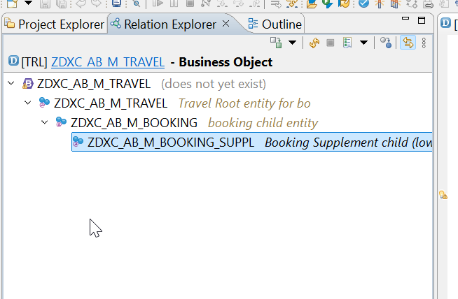
Business Object Definition
From structural point of view, a business object consists of a tree of entities (cds) that are linked in compositions. Every entity in this composition tree is an element that is modeled with CDS view entities. For our demo travel scenario we will implement 3 level composition tree.
/dmo/travel_m
(root entity)
1..N
Business Object
/dmo/booking_m
(child entity)
1..N
/dmo/bookingsuppl_m
(child entity)
www.anubhavtrainings.com

Slide 5

























Slide 6

Development Flow – Processor and Approver
Fiori App – Processor
Create, update, delete, copy travel
Fiori App – Approver
Display the travel request data
Service definition
Service Binding
Service definition
Service Binding
MDE for Processor Projection
MDE for approver Projection
BDEF Projection
For Processor
Expose what is needed by a processor role in company
Behavior Definition (BDEF)
Tell RAP framework regarding our operations which needs to be supported for BO (managed)
BDEF Projection
For Approver
Expose what is needed by a approver role in company
Business Object Projection
For Processor
30 fields to internet
Business Object (definition)
Includes the Travel, Booking and Booking Supplement CDS entities
100 fields
Business Object Projection
For Approver
25 fields
www.anubhavtrainings.com

Slide 7




















Slide 8
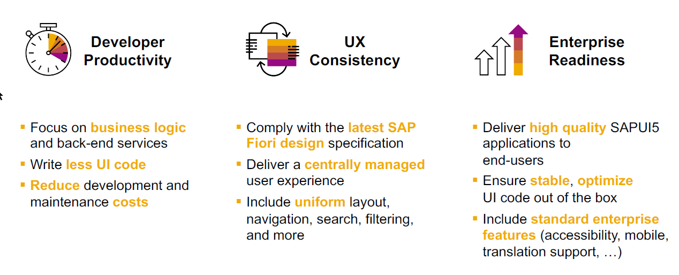
SAP Fiori elements boosts SAP Fiori development efficiency
www.anubhavtrainings.com

Slide 9
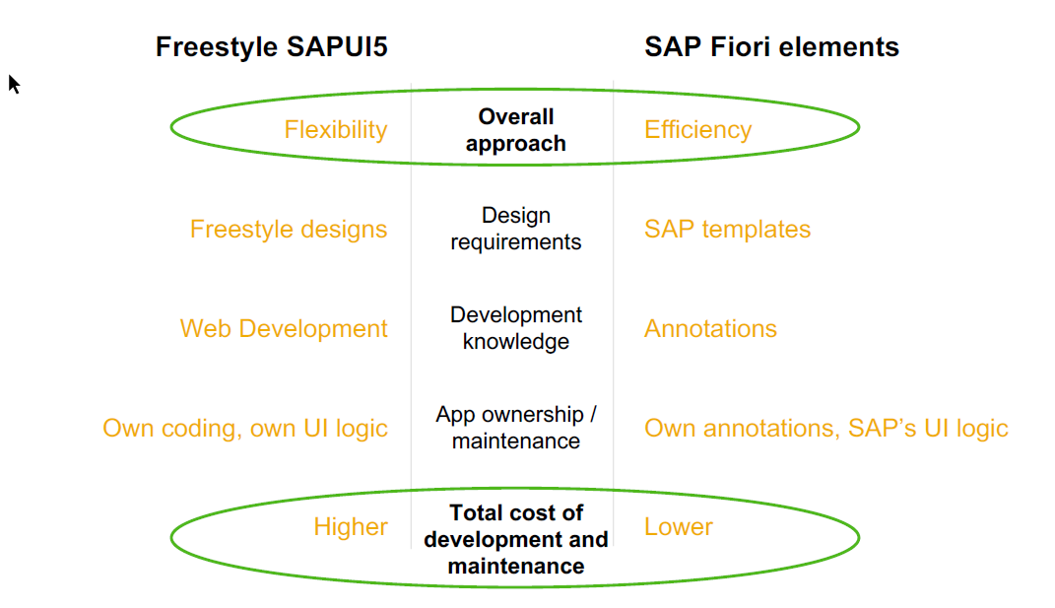
SAP Fiori elements prioritizes efficiency over flexibility
www.anubhavtrainings.com

Slide 10


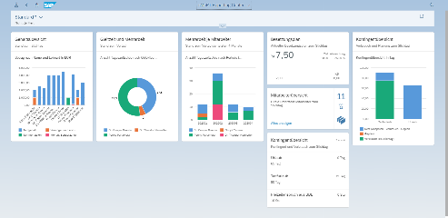





Developer Persona – Fiori Elements
Anubhav
Happy User
Rob
S/4HANA Technical consultant
ABAP Developer
Roxana
UX Designer | Fiori Developer
ABAP Dev. Tools
On
Eclipse
VS Code
BAS
OData Service
Fiori Elements Project
Annotations.xml
CDS Views
MDE
@
www.anubhavtrainings.com

Slide 11
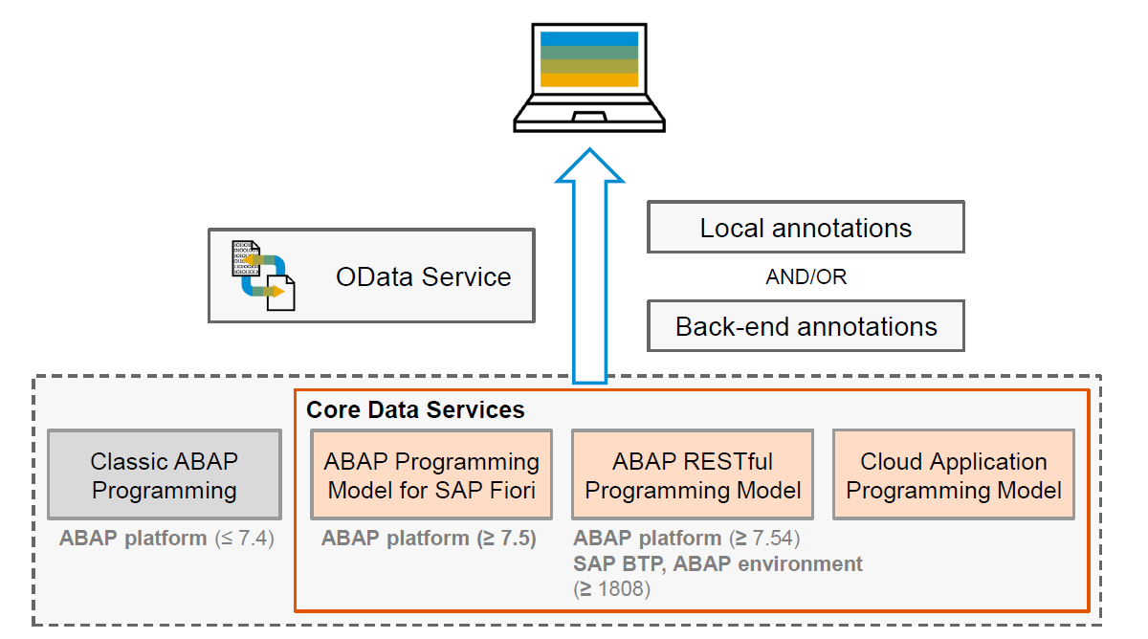
Big Picture – Architecture
www.anubhavtrainings.com

Slide 12
www.anubhavtrainings.com
Thank You
End of Day 9
www.anubhavtrainings.com

Slide 13


We’re committed to empower you to be
#FutureReady
through powerful training solutions.
We build the workforce of the future.
250+
Corporate Clients
30,000+
Learners Trained
25000+
Learners Placed
FREE WEBINARS
Sign up for free webinars with industry experts every fortnight!
Enroll Now!
Contact us today!
https://anubhavtrainings.com

